Slide 1
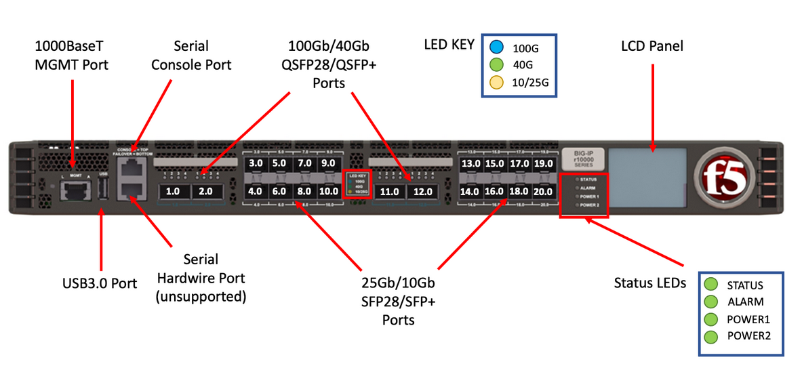
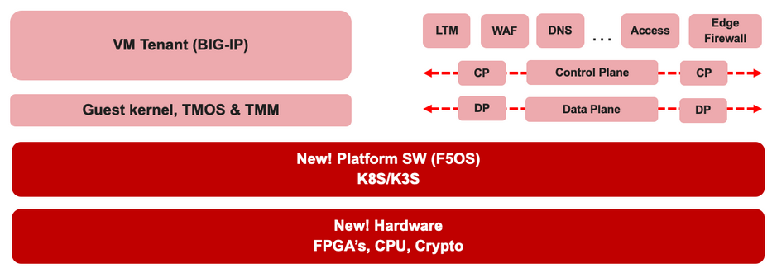

F5 rSeries Learning with
Alexander S

Slide 2
Agenda →
  iSeries to rSeries
  F5OS Basic Setup
  F5OS Upgrade Procedure
  VLAN and LAG Configuration
    Configure VLANs
    Configure LAG (Link Aggregation Group)
    Assign VLANs to the LAG
  Tenant OS Deployment Preparation
  Tenant OS Deployment
  rSeries Tenant Basic Setup
  High Availability (HA) in rSeries Tenants
    Best Practices for rSeries Tenant HA
    rSeries Tenant HA Configuration

Slide 3
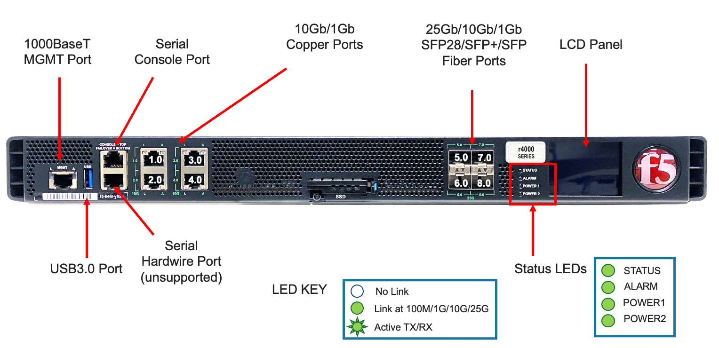
Chapter 2 - rSeries F5OS Basic Setup

Slide 4
2. rSeries Basic Setup – r2800 Hardware Front view

Slide 5
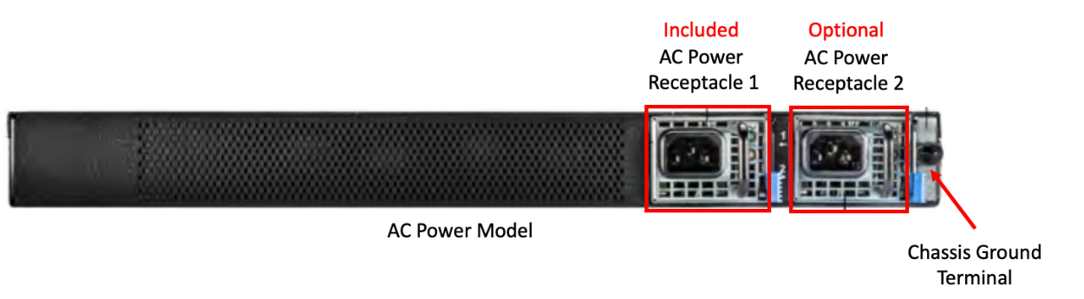
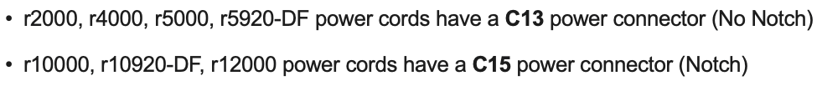
2. rSeries Basic Setup – Install the power supply
Two power supply slots
One power supply unit included. We must buy another one for power supply redundancy
Connect the both the power cables for power supply redundancy.

Slide 6
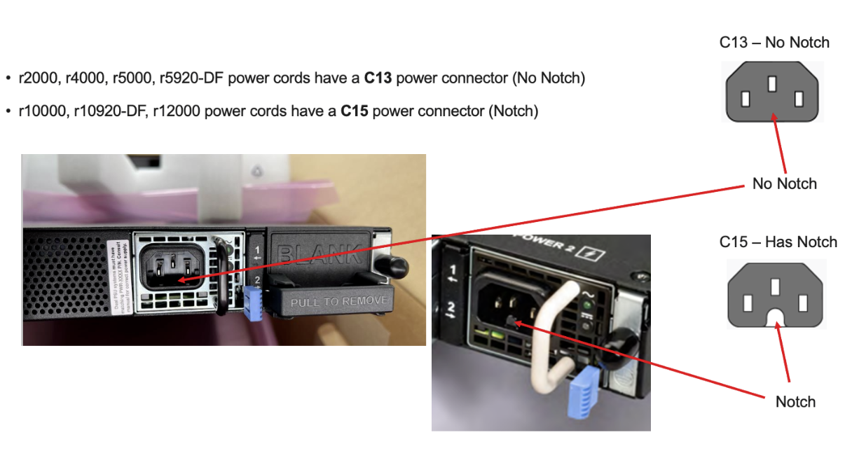
2. rSeries Basic Setup – Install the power supply

Slide 7
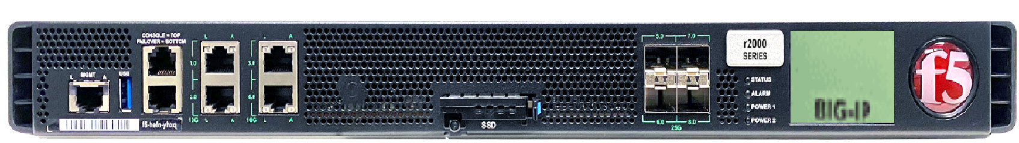
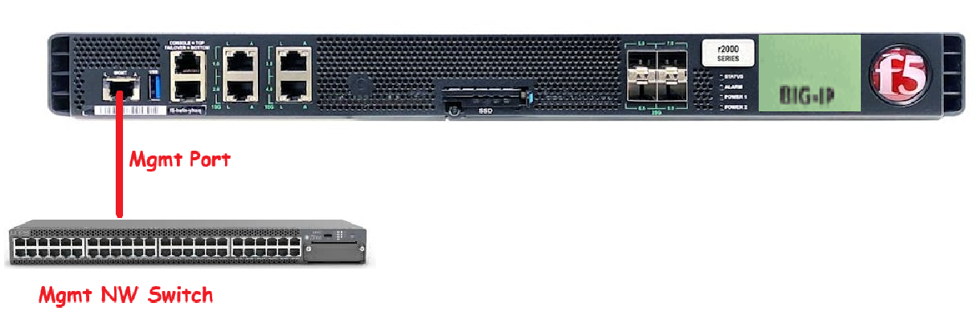
2. rSeries Basic Setup – Power on the rSeries 2800 unit
Power on r2800 unit
Monitor the status in LED
2. rSeries Basic Setup – Connect the management port to management network
Connect the management port to management network switch and make sure the link status is up

Slide 8
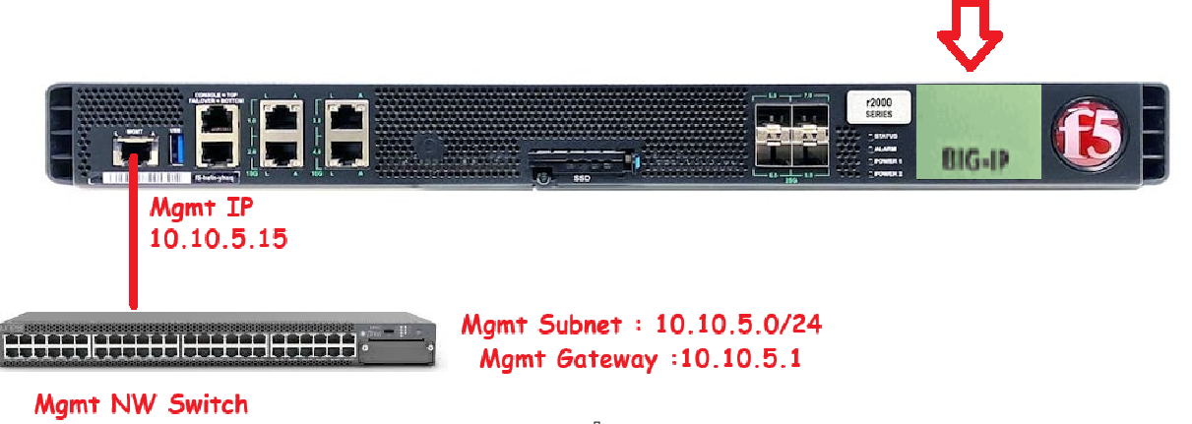
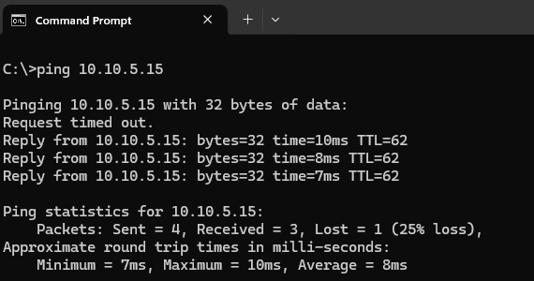
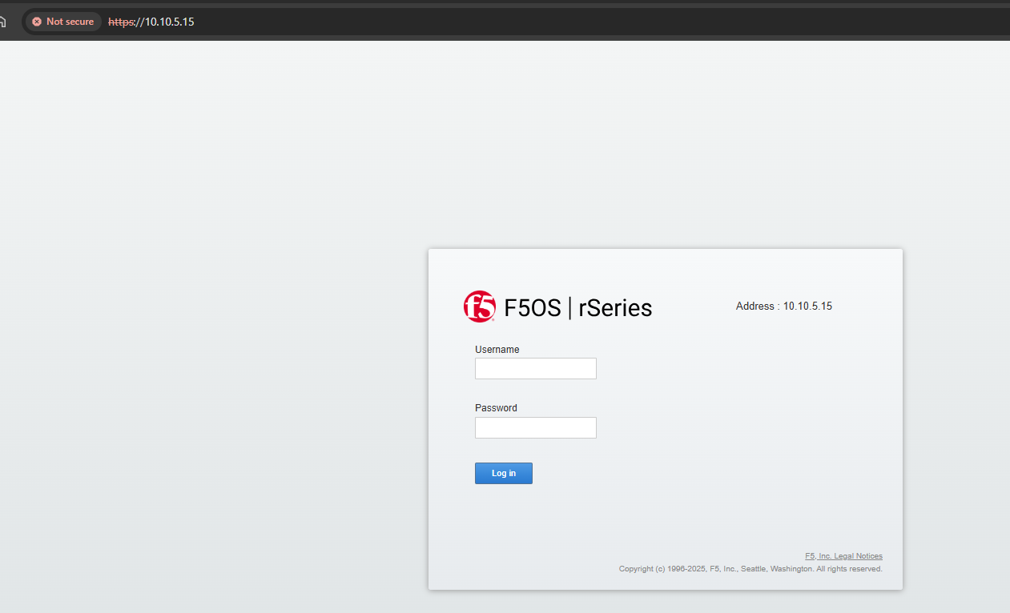
2. rSeries Basic Setup – Configure management ip and access it using WebUI
Configure the management IP, subnet mask and gateway using LED panel.
Verify the management IP is reachable
Access the rSeries platform OS using WebUI.

Slide 9
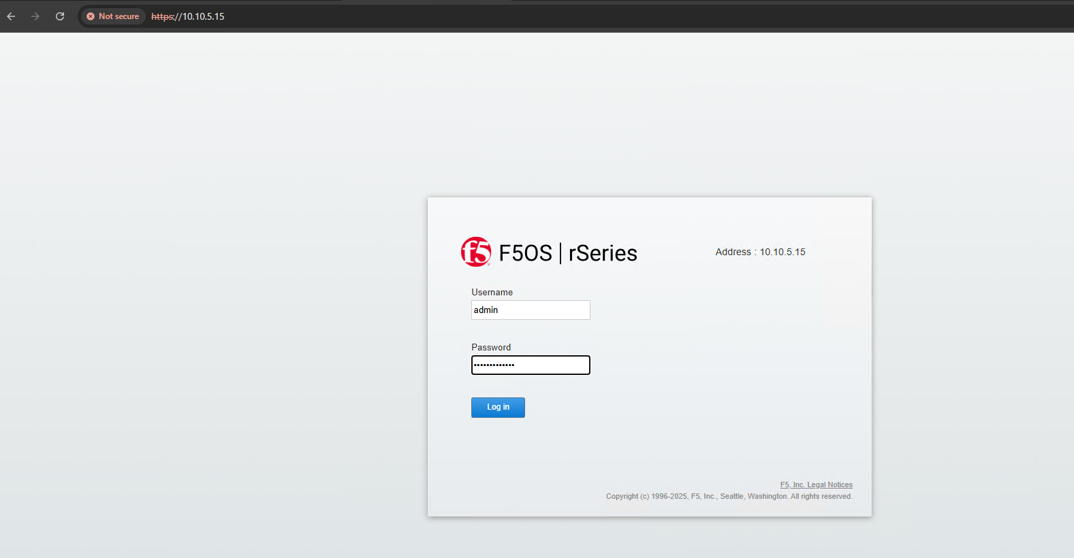
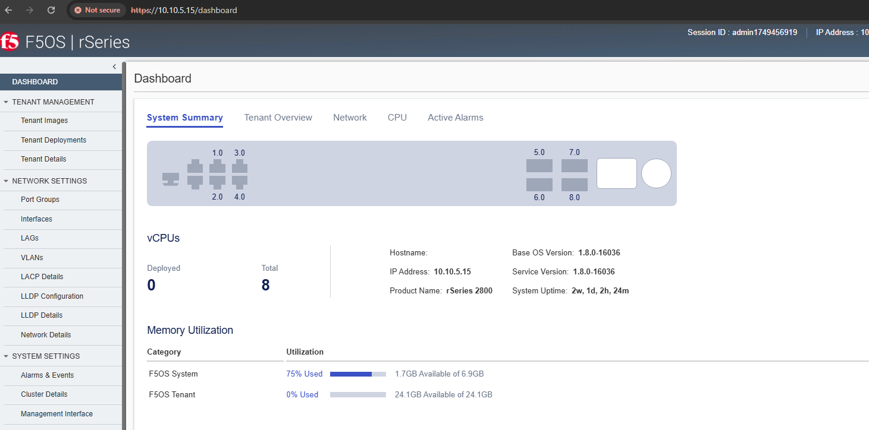
rSeries Basic Setup – Access rSeries Platform
You can access rSeries platform using CLI, WebUI and Rest-API.
The rSeries platform follows a fully API-driven architecture
Access the management IP from Web-UI
Type the default credentials to login admin/admin.
It will prompt you to change the password → typing the current password once and new passwords twice.
Once you setup the new password, you should be able to login to rSeries using your new password.

Slide 10
rSeries F5OS Basic Setup – Tasklist
Configure Hostname
Configure NTP
Configure DNS
Activate the license
How to change the user password

Slide 11
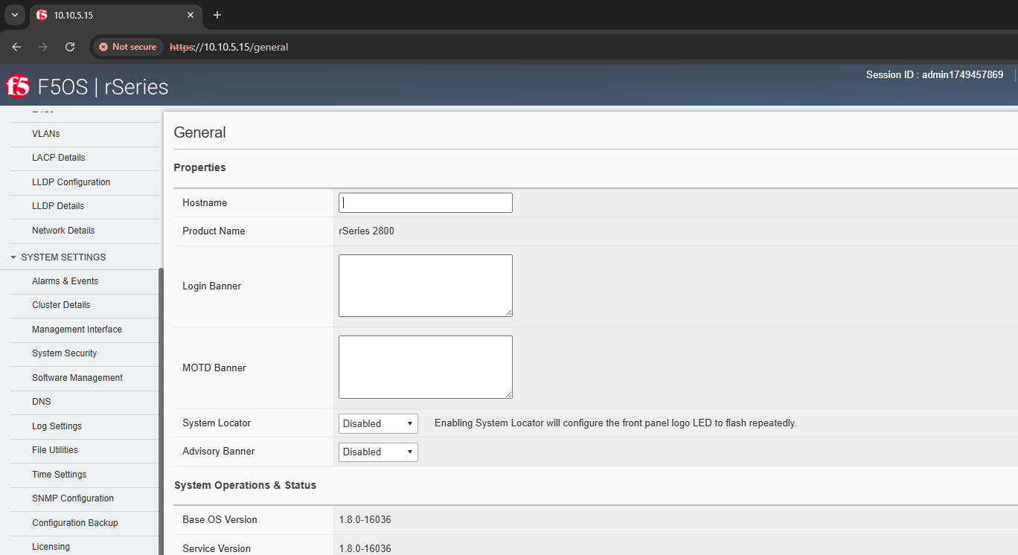
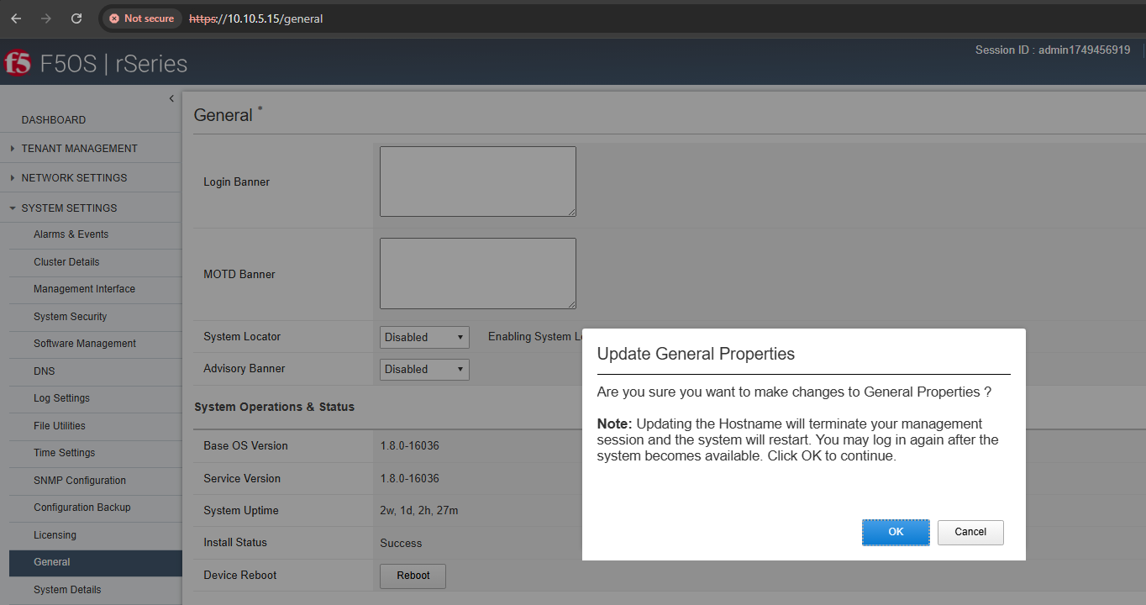
rSeries Basic Setup – Setup the hostname
Under System Settings →General → Under the Hostname → type the hostname you wish to configure.
Once you type hostname, save the changes.
When you save the changes, you will get the alert that “Updating the Hostname will terminate your management session and the system will restart”
This restart only affects the management plane of the F5OS host. Click OK to proceed with it.

Slide 12
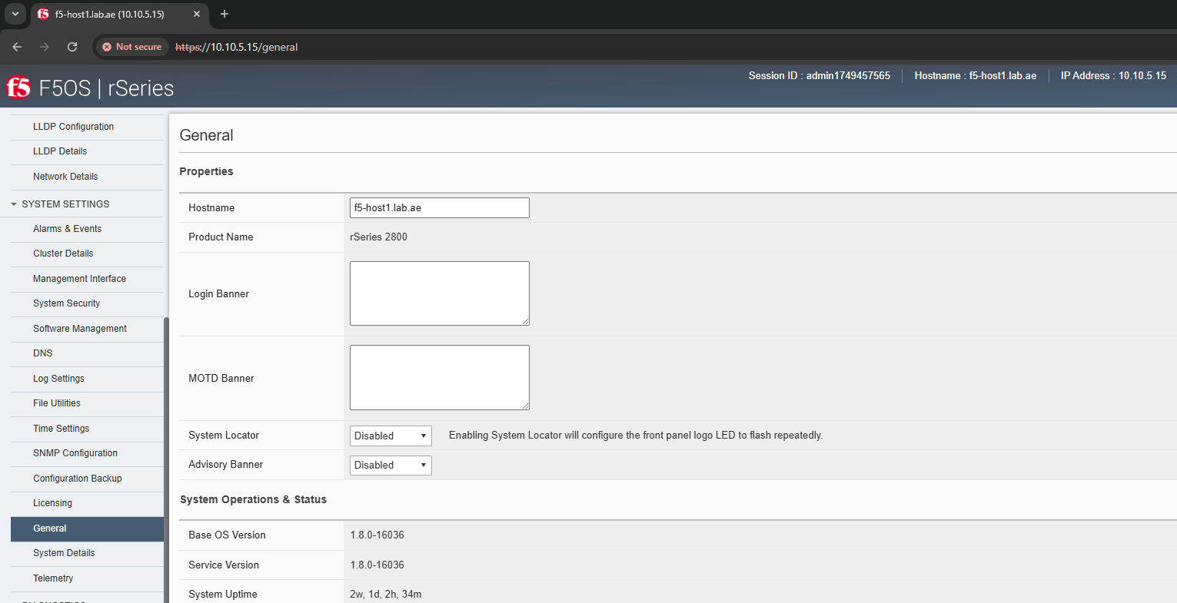
rSeries Basic Setup – Setup the hostname
The management plane restart and logout your current session. Also, you will get the prompt to login again.
Once you logged in, you see the new hostname appear as webpage title.

Slide 13
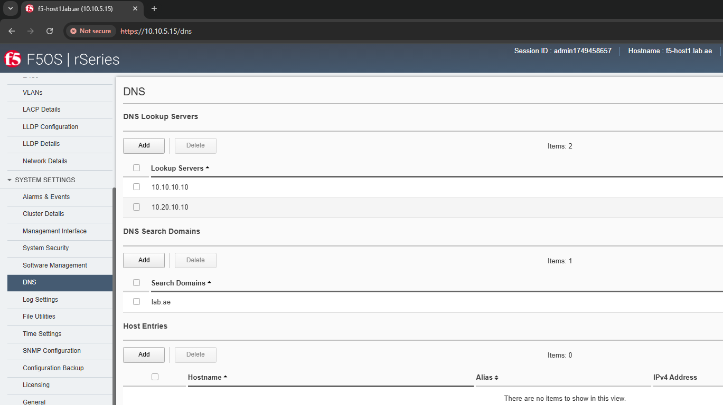
rSeries Basic Setup – Setup the DNS
Under System Settings → DNS → Under the DNS Lookup Servers → Click Add to type your DNS server IP addresses. Click Save & Cloce to save the changes.
Also, under the DNS Search Domains Click Add to type your domain names. Click Save & Cloce to save the changes.

Slide 14
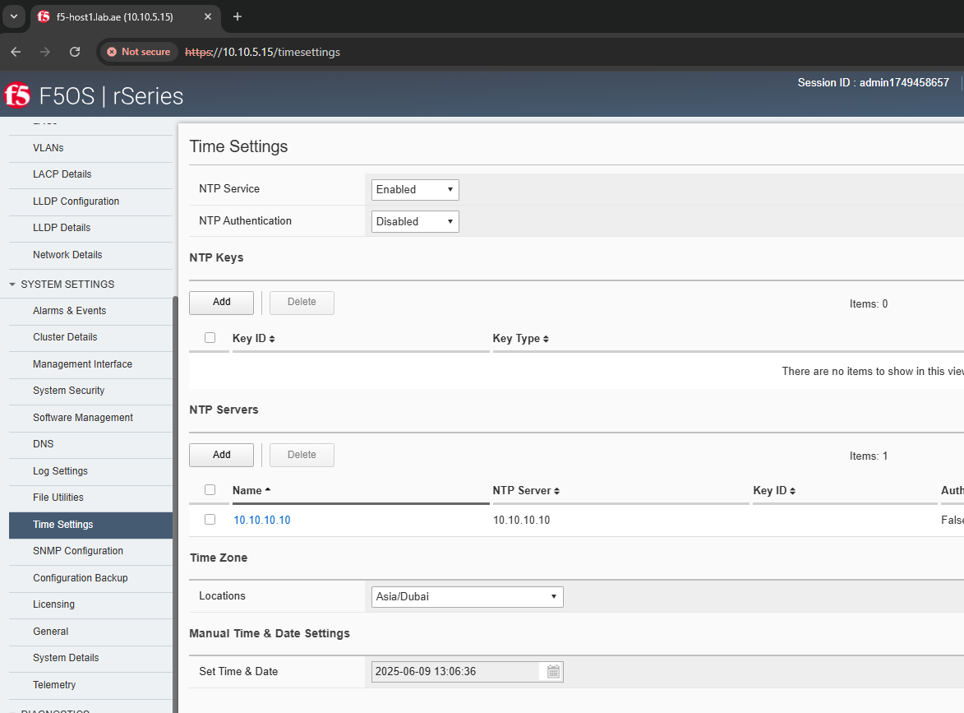
rSeries Basic Setup - Setup the NTP
Under System Settings → Time Settings → Under the Time Settings → Enable the NTP Service. Click Save to Save the changes.
Also, under the NTP Servers Click Add to type NTP Servers. Click Save & Close to save the changes.
Under the Time Zone, setup the correct time as per your country. Example for UAE, Asia/Dubai. Click Save to Save the changes.

Slide 15
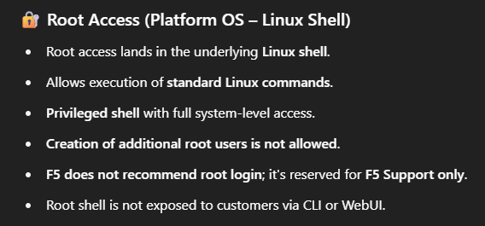
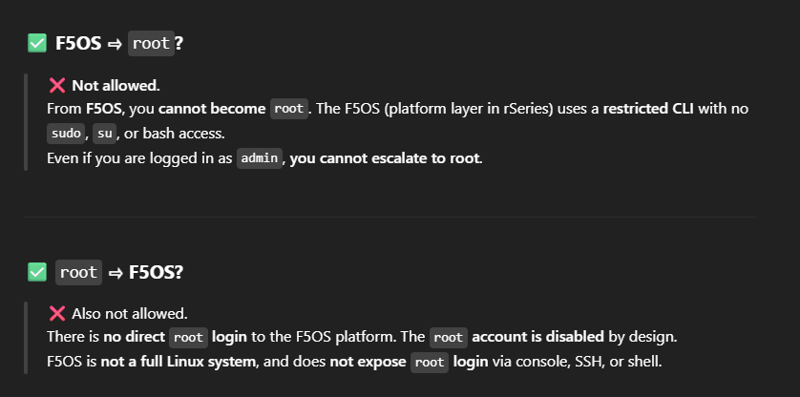
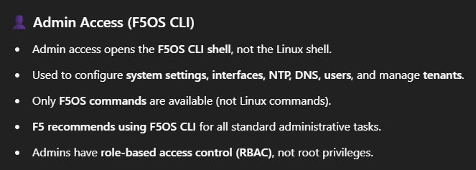
LINUX & F5OS CLI ACCESS – TO TEST NTP & DNS

Slide 16
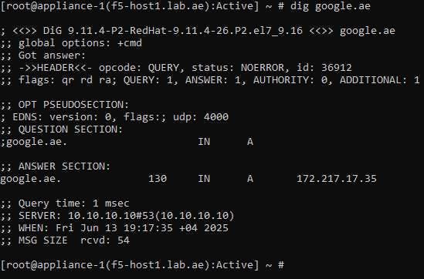
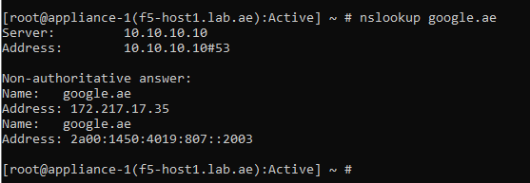
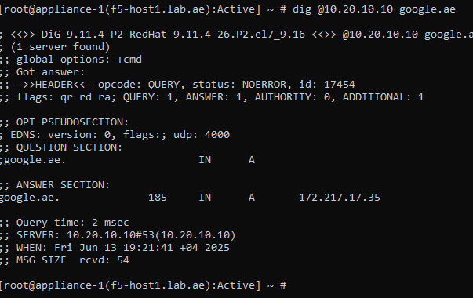
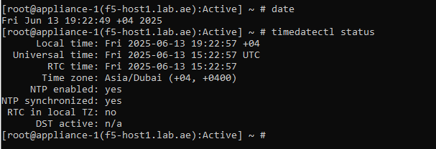
ROOT ACCESS - DNS & NTP CHECK

Slide 17
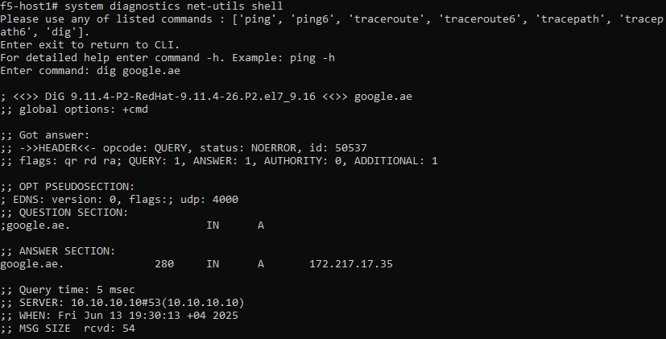
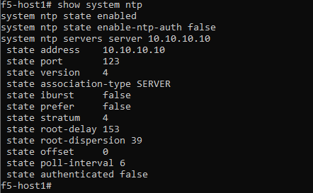
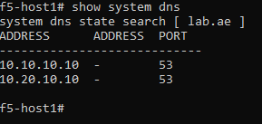
F5OS SSH - DNS & NTP CHECK

Slide 18
LINUX & F5OS Access Restrictions

Slide 19
rSeries Basic Setup – Activate the License
Navigate to System Settings > Licensing, then go to Base Registration Key and click Activate.

Slide 20
rSeries Basic Setup – Activate the License
It opens another page where you can enter the Base Registration Key and Add-on Keys.
Once you've entered all the required information, click Activate.
As long as your DNS is configured correctly and the management IP can connect to the F5 license activation server, the license will be activated successfully.

Slide 21
rSeries Basic Setup – Activate the License
Common F5 License Activation and Update Servers information.
As long as DNS is configured correctly and the management IP can connect to the F5 license activation server over TCP port 443, the license will be activated successfully.
activate.f5.com : Primary domain used for license activation and reactivation.
api.f5.com : Used for license-related API calls.
callhome.f5.com : Used for device communication with F5 (Call Home / reporting).
downloads.f5.com : Used for downloading software, updates, and EULA confirmations.
cdn.f5.com : Content delivery network used for software updates and packages.
beacon.f5.com / telemetry.f5.com (optional) : Used for sending telemetry data (for F5 Beacon / F5 Distributed Cloud integrations).

Slide 22
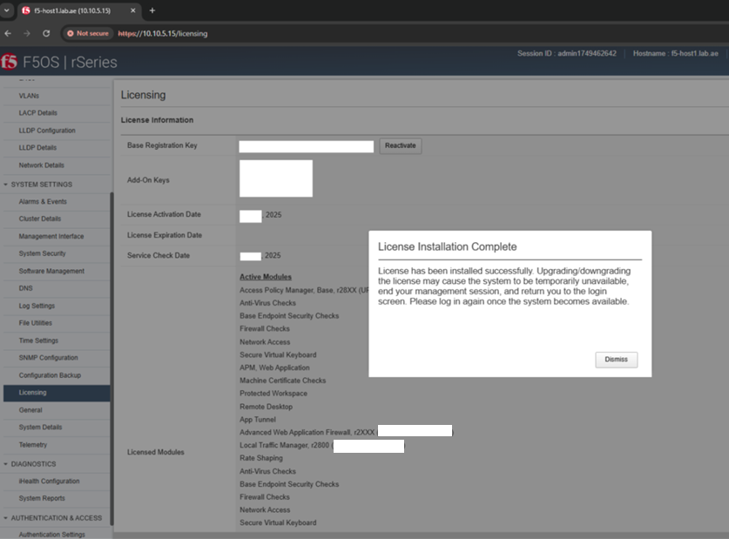
rSeries Basic Setup – Activate the License
Upon successful activation, a confirmation message will appear.

Slide 23
rSeries Basic Setup – Activate the License
You can now view all the activated licenses in the rSeries.
Similar to the iSeries, rSeries tenants inherit their licenses from the F5OS host.

Slide 24
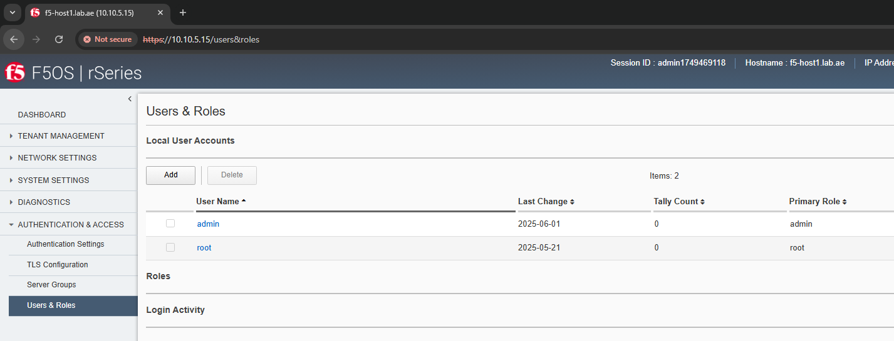
rSeries Basic Setup – Change the user password
Under Authentication & ACCESS → User & Roles → Choose & Click the account to change the password.

Slide 25
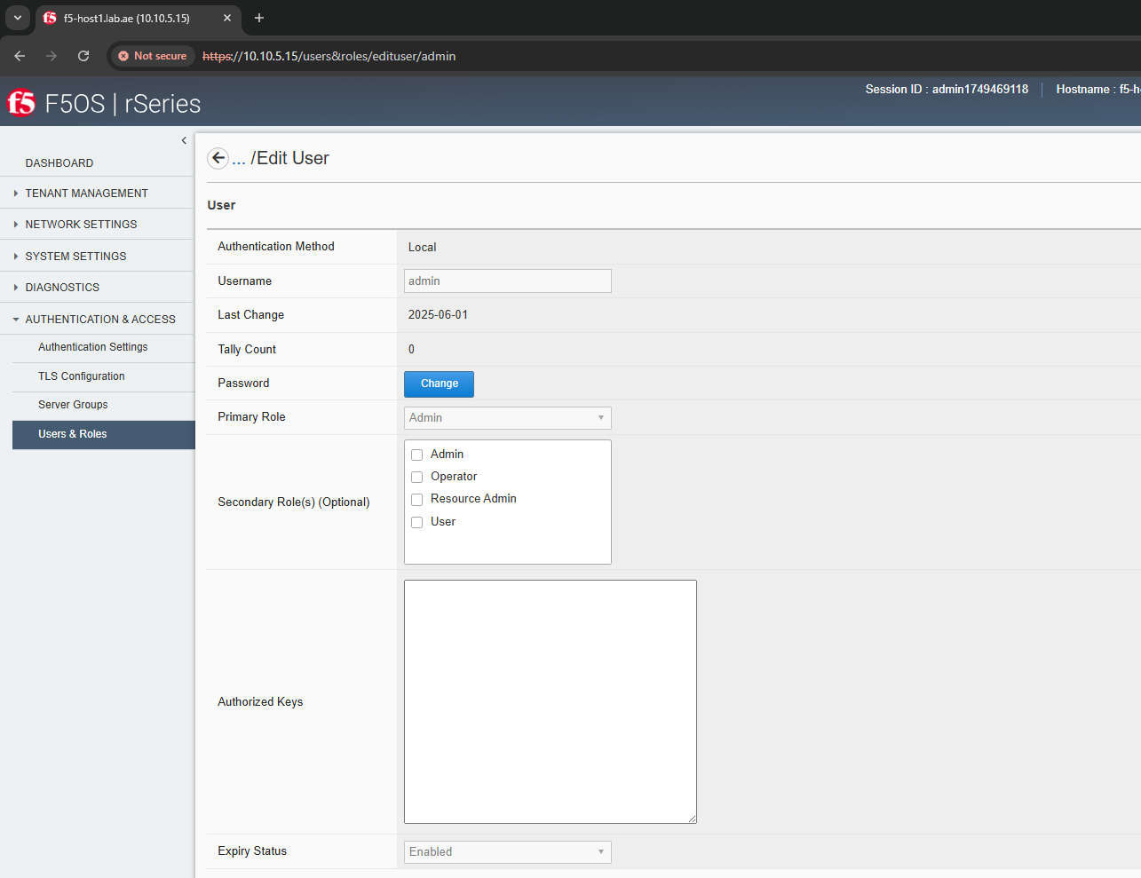
rSeries Basic Setup – Change the user password
Once the user page opened as Edit user, click Change

Slide 26
rSeries Basic Setup – Change the user password
Here, you have to type
The current password once
New password once
Confirm new Password once

Slide 27
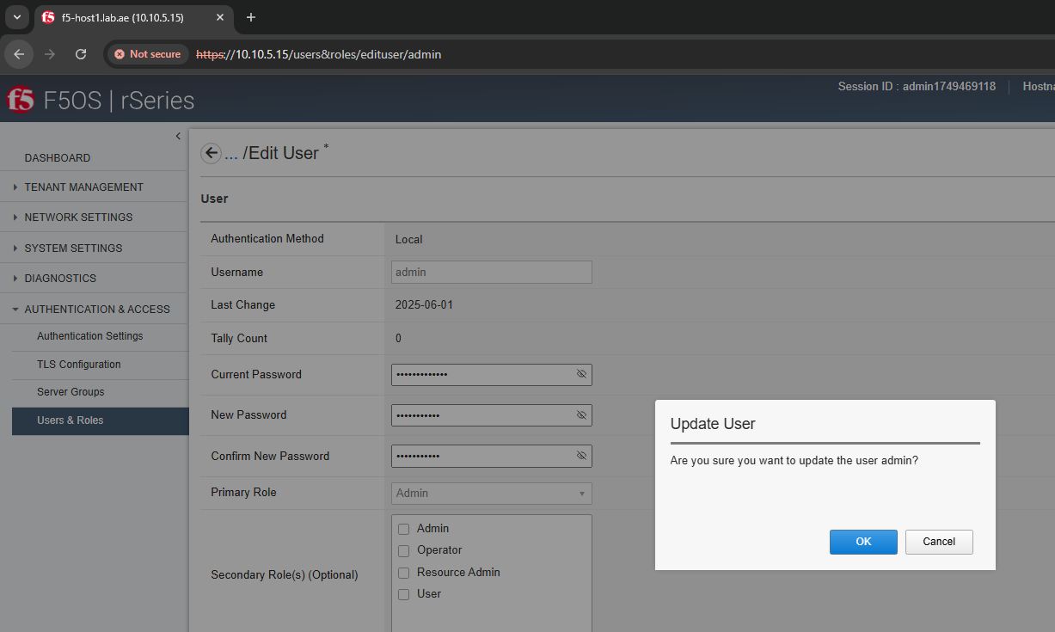
rSeries Basic Setup – Change the user password
Than click Save & Close
It will prompt “Are you sure you want to update the user admin”

Slide 28
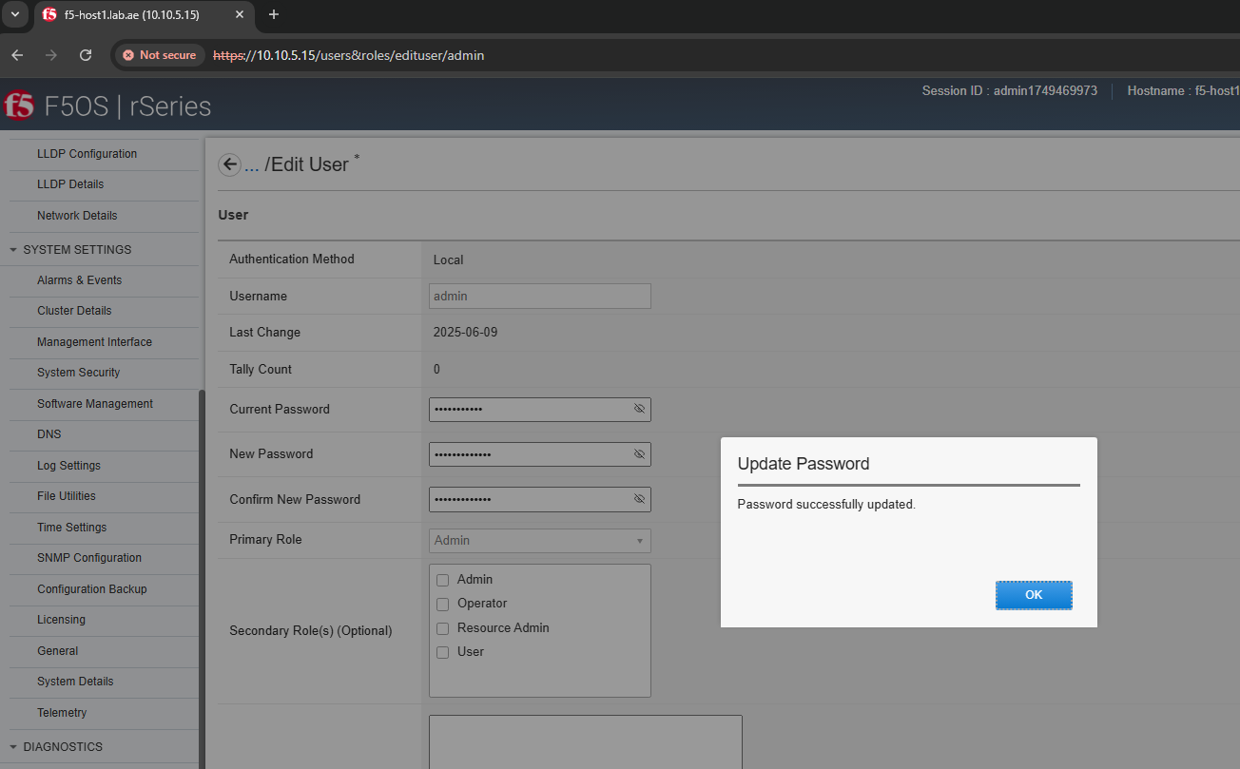
rSeries Basic Setup – Change the user password
After updating the password, a message will appear: “Password successfully updated.”
The system will then log you out and redirect you to the login page.
You can now log in using your new password.

Slide 29
rSeries F5OS Basic Setup – Summary
Configured Hostname
Configured DNS
Configured NTP
Activate the license
How to change the user password

Slide 30
Please continue by watching the next video.
Next video is – rSeries F5OS upgrade – Thank you!!!

