Slide 1
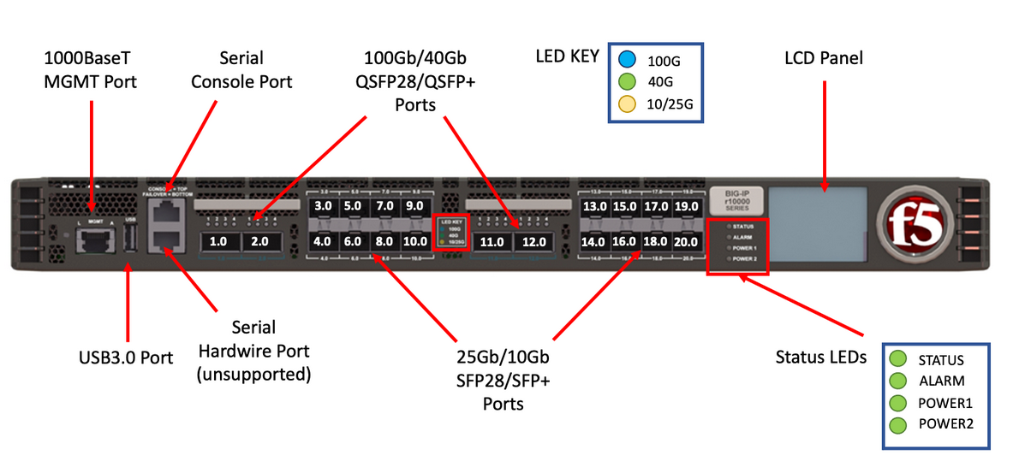
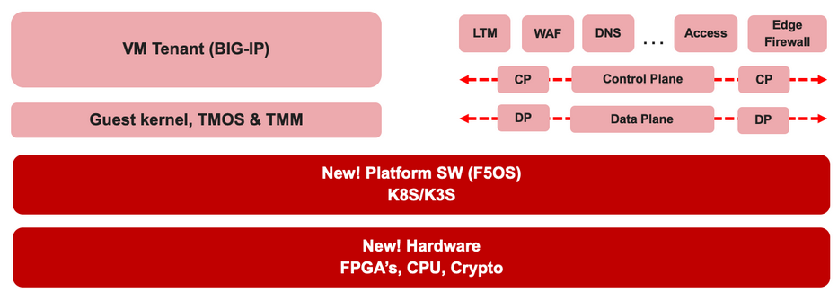

F5 rSeries Learning with
Alexander S

Slide 2
Agenda →
  iSeries to rSeries
  F5OS Basic Setup
  F5OS Upgrade Procedure
  VLAN and LAG Configuration
    Configure VLANs
    Configure LAG (Link Aggregation Group)
    Assign VLANs to the LAG
  Tenant OS Deployment Preparation
  Tenant OS Deployment
  rSeries Tenant Basic Setup
  High Availability (HA) in rSeries Tenants
    Best Practices for rSeries Tenant HA
    rSeries Tenant HA Configuration

Slide 3
Chapter 01 - iSeries to rSeries

Slide 4
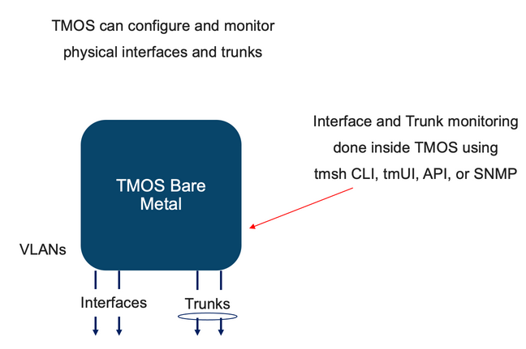
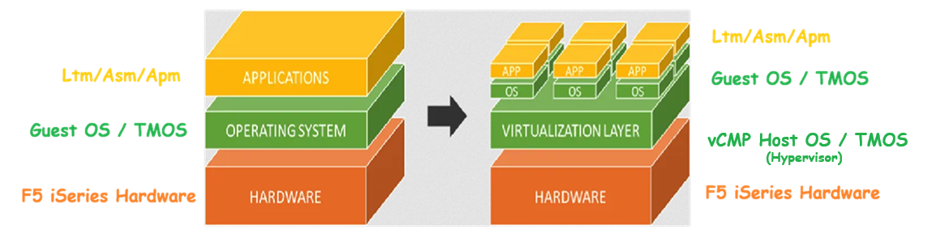
1. iSeries to rSeries : iSeries Non-Virtualized Model
iSeries
TMOS runs directly on F5 bare-metal hardware.
It is responsible for configuring and monitoring interfaces and trunks.
Virtualization is not mandatory in TMOS. In fact, it is an add-on licensed feature in iSeries platforms.

Slide 5
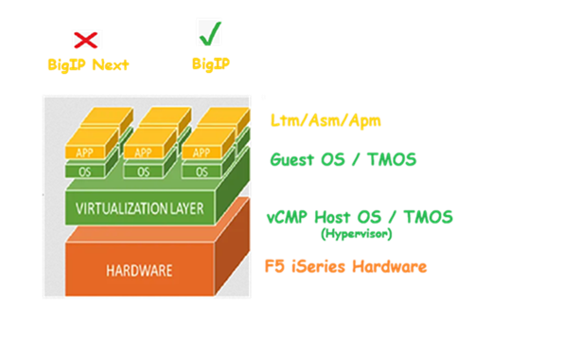
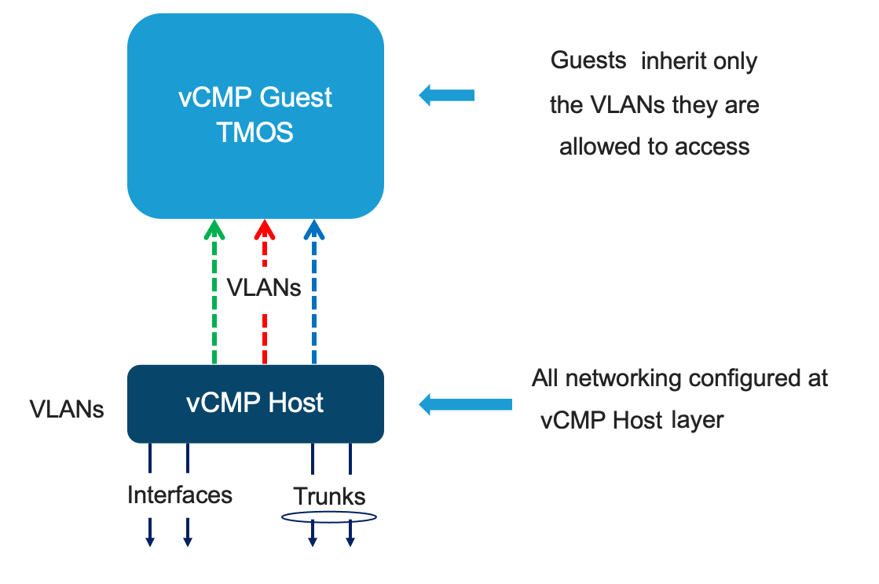
1. iSeries to rSeries : iSeries Virtualized Model
TMOS is the platform OS that runs directly on F5 iSeries hardware (bare metal).
vCMP is a licensed module within TMOS that enables virtualization.
When vCMP is enabled, TMOS becomes the vCMP Host (hypervisor role).
The vCMP Host virtualizes the system into multiple vCMP Guests, each of which runs a dedicated TMOS instance (you can only run TMOS as a guest OS).
Interfaces, trunks, and VLANs are configured and monitored at the vCMP Host level and assigned to guests as needed.
Guests inherit only the vlans they are allowed to access.

Slide 6
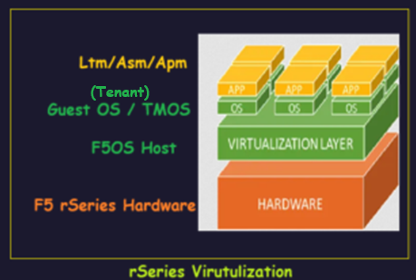
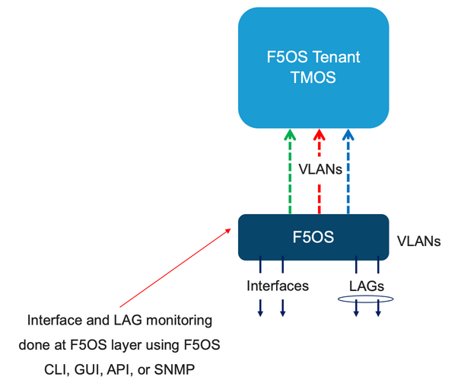
1. iSeries to rSeries : rSeries must virtualized
rSeries
TMOS cannot run on F5 bare metal hardware and Virtualization is mandatory using F5OS. TMOS will run as tenant.
It is always F5OS run on bare metal hardware to virtualize the platform
F5OS will configure and monitor the interfaces and trunks

Slide 7
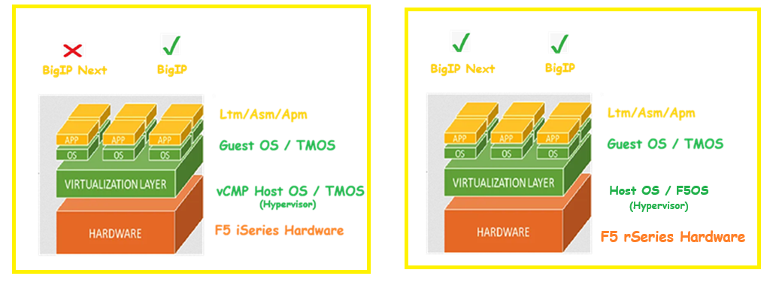
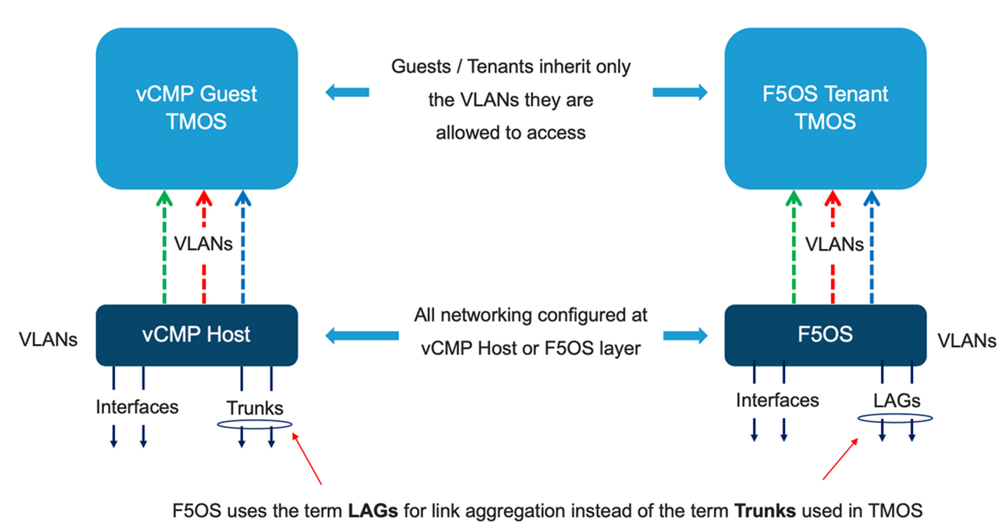
1. iSeries to rSeries : rSeries Virtualized Model
TMOS cannot run directly on F5 rSeries bare metal hardware. Virtualization is mandatory, and the platform must run new “Kubernetes-based platform layer called F5OS” as the base operating system.
The “Modernized F5OS Built-in with a micro services-based architecture”. It runs natively on the hardware and acts as the platform OS, providing virtualization services and system management.
TMOS runs as a tenant (guest) inside F5OS and cannot run without F5OS on rSeries.
Also, F5OS supports multiple mixed tenants, such as:
  Traditional BIG-IP (TMOS) tenants
  BIG-IP Next tenants (microservices-based)
All hardware-level networking configuration - including interfaces, Link Aggregation Groups (LAGs, not called trunks anymore), and VLANs - is done at the F5OS platform layer.
Tenants are assigned only the VLANs they are allowed to use, and cannot directly configure or monitor physical interfaces or LAGs.

Slide 8
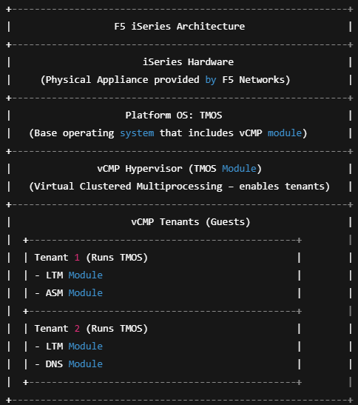
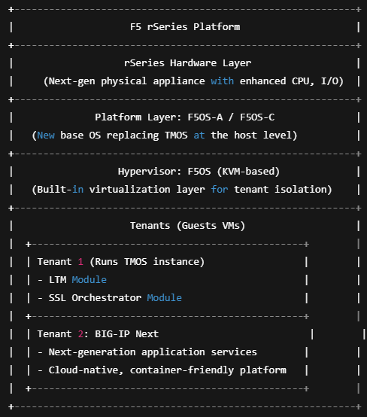
1. iSeries to rSeries – Both support virtualization

Slide 9
1. iSeries to rSeries – Comparison
Feature | iSeries (Bare Metal) | iSeries with vCMP | rSeries with F5OS
Virtualization Support | ❌ None | ✅ vCMP (Virtual Guests) | ✅ F5OS (Containerized Tenants)
Layers of Management | 1 (TMOS only) | 2 (vCMP Host + TMOS Guests) | 2 (F5OS Platform + TMOS Tenants)
Platform Layer OS | TMOS (monolithic) | TMOS with vCMP module | F5OS (Linux + KVM + Kubernetes)
Guest/Tenant OS | N/A (single TMOS instance) | TMOS (per guest) | TMOS (per tenant)
Interface Configuration | Directly in TMOS | In vCMP Host | In F5OS Platform Layer
VLAN Assignment | Configured in TMOS | Assigned to Guests by Host | Assigned to Tenants by Platform
Interface Aggregation | Trunks | Trunks | LAGs (Link Aggregation Groups)
Network Access Control | Full access via TMOS | Limited to assigned VLANs per guest | Limited to assigned VLANs per tenant
Monitoring – Networking | Done in TMOS | TMOS MIBs (Host + Guest) | F5OS SNMP MIBs (platform) + TMOS in tenants
Monitoring – Application | TMOS SNMP MIBs | TMOS MIBs in guest | TMOS MIBs in tenant
API Support | TMOS iControl REST | TMOS iControl REST (per guest) | F5OS APIs + TMOS iControl REST (per tenant)
Use Case | Simpler deployments | Multi-tenant, flexible | Modern, API-driven, cloud-aligned architecture

Slide 10
Please continue by watching the next video.
Next video is - rSeries Basic Setup – Thank you!!!

